Slide 1
The Emergence of Edge Computing
Mahadev Satyanarayanan, Carnegie Mellon University

Slide 2
Agenda
Background
Introduction
Why edge computing
Challenge and future
Conclution

Slide 3
Background
Emergence services using cloud computing: IoT, AR, Siri, Google Home, Amazon Alexa…
Problem: Delay, Round trip time, Jitter
The average round-trip time from 260 global vantage points to their optimal Amazon Elastic Compute Cloud (EC2) instances is 74 ms.
Notes:
vantage points: PlanetLab 是分布於全球的計算機群，所有的機器都連上網路，可以提供產品測試，測試完可以直接放到網路上，目前有提供CDN的服務
74ms是最理想的狀況，還不包括無線傳輸跟訊號不穩定的問題

Slide 4
Background
For a human
Face recognition takes 370–620 ms, depending on familiarity.
Speech recognition takes 300–450 ms
Only 4ms to tell that a sound is a human voice.
VR applications that use head-tracked systems require latencies of less than 16 ms to achieve perceptual stability.
Notes:
要16ms以下的delay人才察覺不到，這樣光rtt就74了絕對不行

Slide 5
Background
To mask lack of proximity: A direct fiber connection can achieve low latency and high bandwidth between distant points.
Speed of light
Queuing and routing delay
Content Delivery Networks (CDNs)
Make content close to user
Make computing resource close to user
Notes:
就算是用光纖在不同網域要做跳轉的時候還是會有queuing跟轉換的routing delay
不把cloud data center蓋到所有地方是因為成本太高

Slide 6
Introduction
What is Edge Computing?
Frst articulated in a 2009 article (two level architecture).
Edge is any computing and network resource along the path between data sources and cloud data centers(2013).
Computing offload
Data caching/storage
Data processing
IoT management
Privacy protection
Mobile device can do edge computing
Notes:
任何介於資料跟雲端中間具備運算能力的東西都可以叫edge

Slide 7
Introduction
Cloudlet
Like CDN
Server placed at the Internet’s edge in close proximity to mobile devices or sensors.
Layer between user and cloud
Process easier task
Training on cloud, using on cloudlet
Akamai, IBM, Amazon...

Slide 8
Why edge computing
Highly responsive cloud services
Scalability via edge analytics
Privacy-policy enforcement
Masking cloud outages

Slide 9
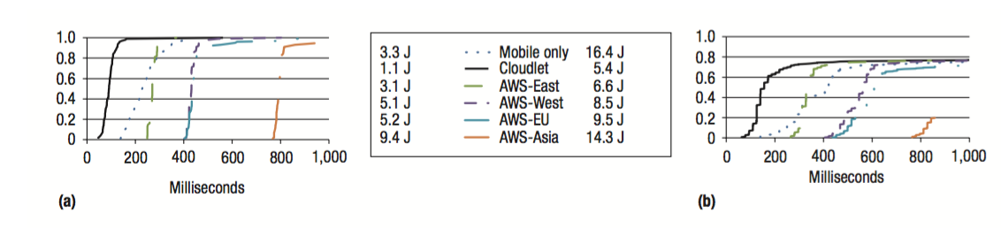
Highly responsive cloud services
An image from the mobile device in Pittsburgh (East United State)
AR
Face Recognition
Notes:
Pittsburgh 美國東部的城市
cloudlet 跟 AWS 來比，cloudlet 的反應時間明顯快很多，隨著離上傳照片的地點越遠 response time 跟 energy 也越大
mobile 在 AR 的表現不錯，因為傳圖片的傳輸成本比較高，而在這個實驗中對圖片做處理的演算法比較簡單，處理的成本比較低，所以他的表現可以勝過傳到 AWS 的，但在 face recognition 只能在一些比較簡單處理的圖片勝出，因為演算法比較複雜，消耗的能量也大很多，但回過頭跟 cloudlet 相比還是都輸

Slide 10
Highly responsive cloud services
Enabling new applications that are both computation-intensive and latency-sensitive
Google Glass
The sensor inputs are analyzed to extract a symbolic representation of task progress
Operates solely on the symbolic representation
Notes:
A prime example is wearable cognitive assistance
google glass 就是基於 cloudlet 運算來呈現資訊或者給使用者一些引導
工作流程有兩個部分：1) Sensor inputs -> symbolic representation 2) 對 symbolic representation 做運算

Slide 11
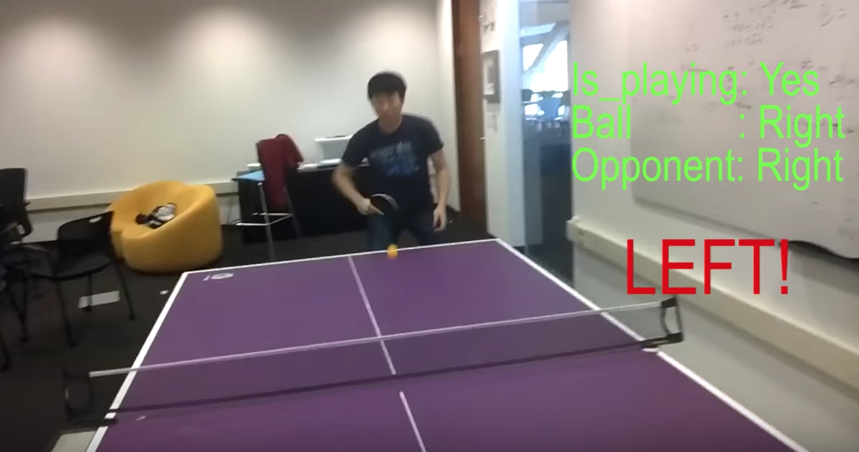
symbolic representation

Slide 12
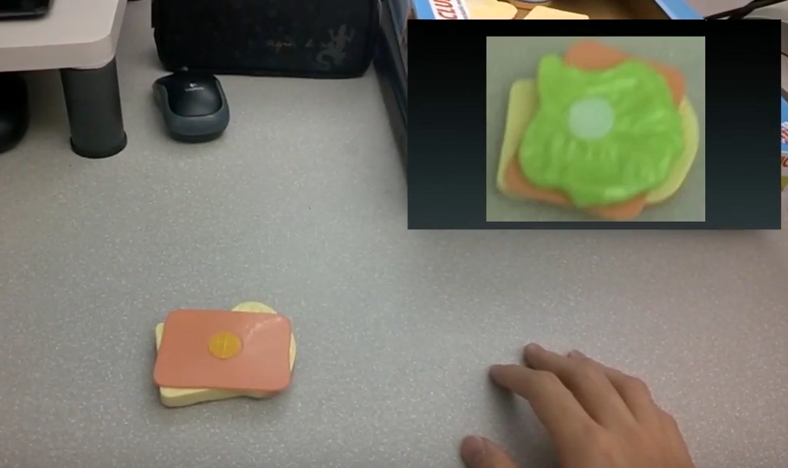
symbolic representation

Slide 13
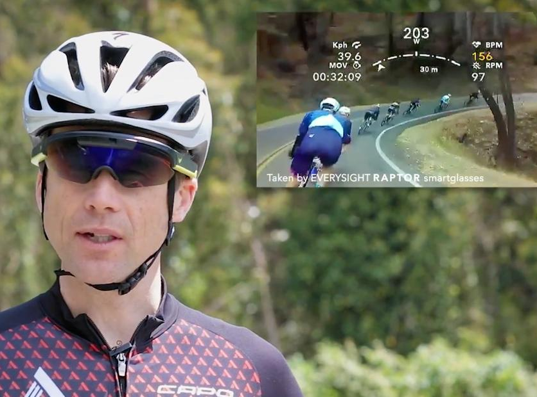
Scalability via edge analytics
12,000 users transmitting 1080p video would require a link of 100 gigabits per second; a million users would require a link of 8.5 terabits per second
GigaSight framework

Slide 14
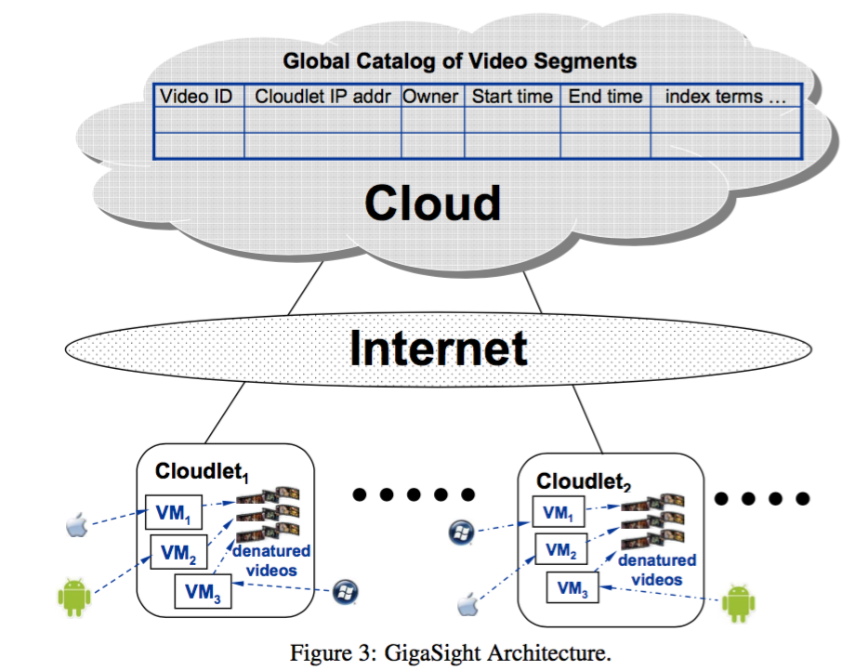
Notes:
video from a mobile device only travels as far as a nearby cloudlet
只會把算出來的結果(content tags, recognized faces) 和 metadata(owner, capture location, timestamp, and so on) 傳到雲端上
因為他在 cloudlet 就做完資料處理了，只把結果和 metadata 傳到雲端上，就可以不讓過多的流量跑到雲端去

Slide 15
Scalability via edge analytics
Application in other high-data-rate sensors
Modern aircraft
generate half a terabyte of sensor data during a flight
Automobile
sensor streams from the engine and other sources
Notes:
飛機：有沒有異常狀況
車子：透過即時分析來自引擎的資料，提醒駕駛者車子有異常
車子2: 如果這個 cloudlet 未來是電信基礎建設的一部份，或者駕駛者在路上遇到一些障礙物（例如突然倒下的樹），當 sensor 感測到，就能透過 cloudlet 即時通知其他駕駛，避免更多的意外發生

Slide 16
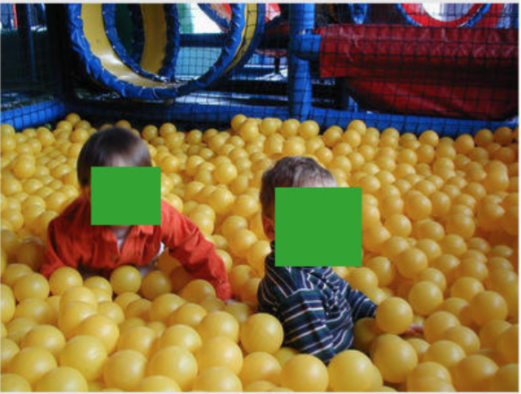
Privacy-policy enforcement
Growing concerns over data privacy arising from IoT system overcentralization
Denatured sensor data
Notes:
Denatured sensor data: 1) 模糊照片、模糊人臉、特定時間擷取到的影像不要上傳 2) 現今 Iot 的運作模式都是直接把 raw data 傳到雲端，不會做 denature

Slide 17
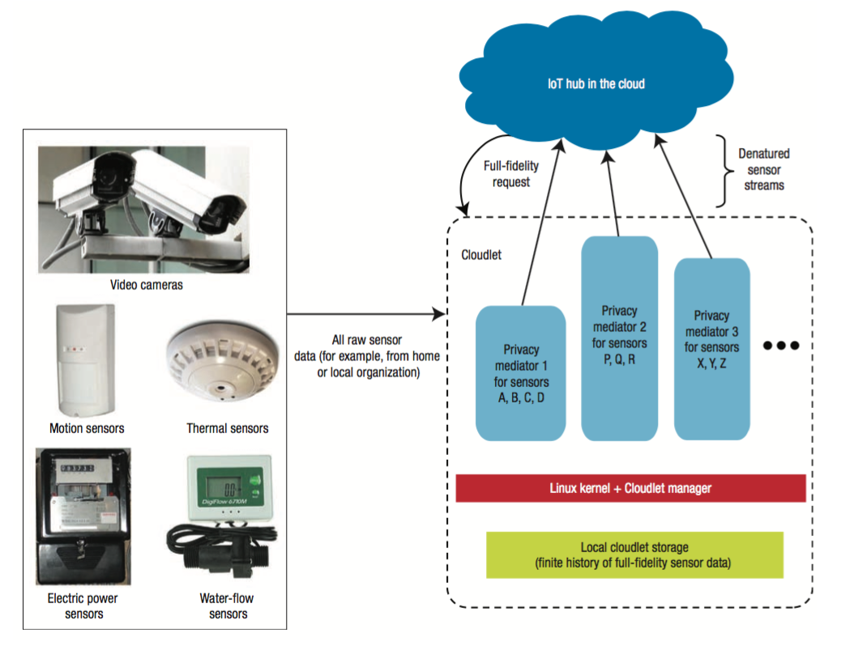
Notes:
IoT privacy architecture proposed by Nigel Davies and his colleagues

Slide 18
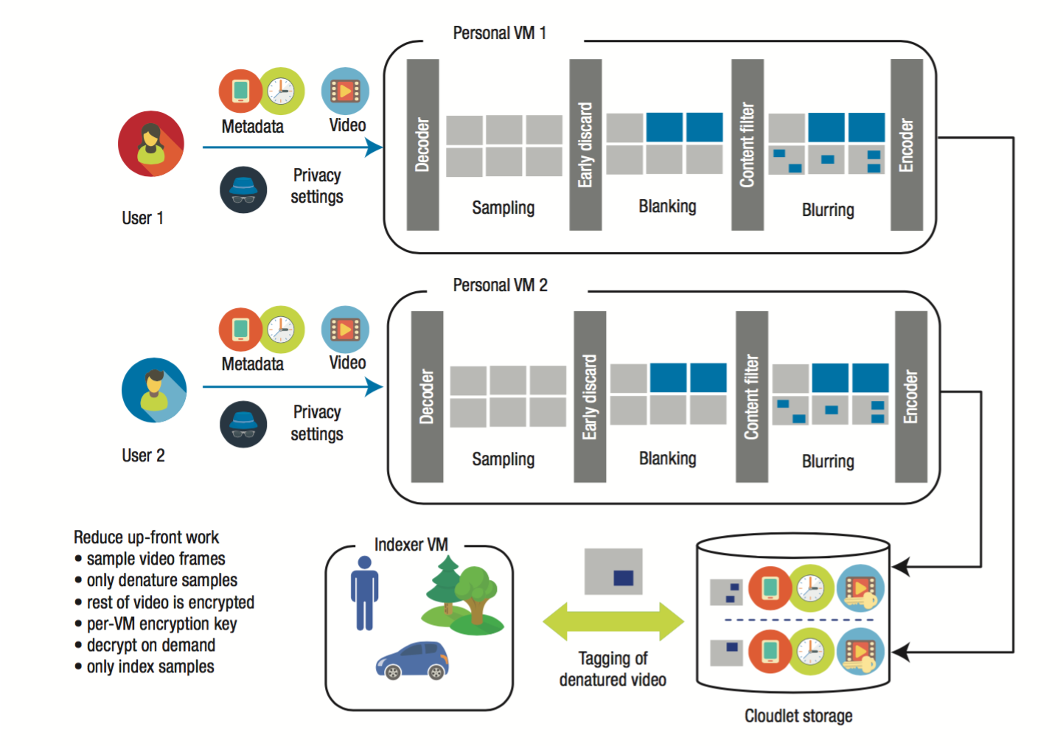
GigaSight
Notes:
Privacy setting : 看你要設定哪些時間不要上傳，或者要不要模糊人臉之類的

Slide 19
Masking cloud outages
Hostile environments
A cloudlet can serve as a proxy for the cloud and perform its critical services
Notes:
hostile environments：網路環境不好、天災讓網路基礎建設壞掉、DDoS 攻擊，導致雲端 failure
等 cloud 好了之後，cloudlet 再把資料給 cloud

Slide 20
Challenge and Future Work
The dispersion inherent in edge computing raises the complexity of management considerably.
Weaker perimeter security of cloudlets.
Tamper-resistant and tamper-evident enclosures, remote surveillance, and Trusted Platform Module–based attestation
Develope deadlock
World Wide Web: killer app
OpenStack++
Notes:
雖然cloudlet可以做到privacy加強，但是因為他是比較小型的server又分散在各處，管理沒有那麼容易，所以還是存在安全性問題，使用者也不一定會信任這樣的裝置
要做防竄改跟遠端監控跟建造可以被信任的環境

Slide 21
Conclution
Three trends lead to emergence of edge computing:
Software-defined networking (SDN) and the associated concept of network function virtualization (NFV)
5G networks
Mobile devices’ improvements are muted by the fundamental challenges of mobility such as weight, size, battery life, and heat dissipation.
Sweet spot: Amplify the capabilities of proximate mobile devices and sensors.
Notes:
SDN是用軟體管理網路的方法，傳統封包要怎麼傳都是寫在硬體裡面，要更新就要去透過硬體廠商提供的韌體去改很麻煩，現在把送封包跟控制要怎麼送拆開，讓軟體來控制只會傳送封包的硬體，就可以提高自由度
NFV是把一些本來寫都是硬體的服務軟體化，像是防火牆，router，他讓這些本來是寫在硬體的功能虛擬化，就不用為了加這些功能去到當地安裝硬體

